Slide 1
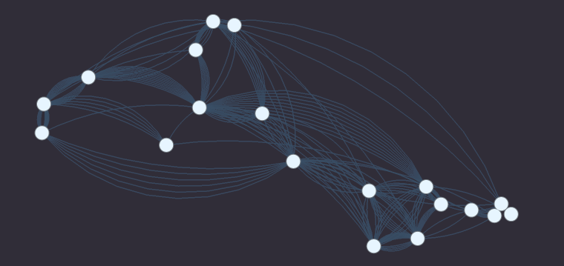
Maximizing Influence and Fairness in Social Networks at Scale
TEAM INFLUENCERS
David Peletz
Autumn Rains
Sophia Skowronski
Alissa Stover
RESEARCH
Alberto Todeschini
Puya Vahabi
Notes:
Hello, we are Team Influencers

Slide 2
How might we maximize the spread of information on social media…fairly?
Notes:
How might we spread a message in a social media network, in a way that maximizes its spread but in a balanced fashion with respect to sensitive demographic characteristics? This kind of problem could apply to any kind of message, such as an ad for a product we are selling or sharing important public health messages like information about the COVID-19 vaccine. In this project, we focused on replicating a case study of an algorithmic solution to this problem.

Slide 3
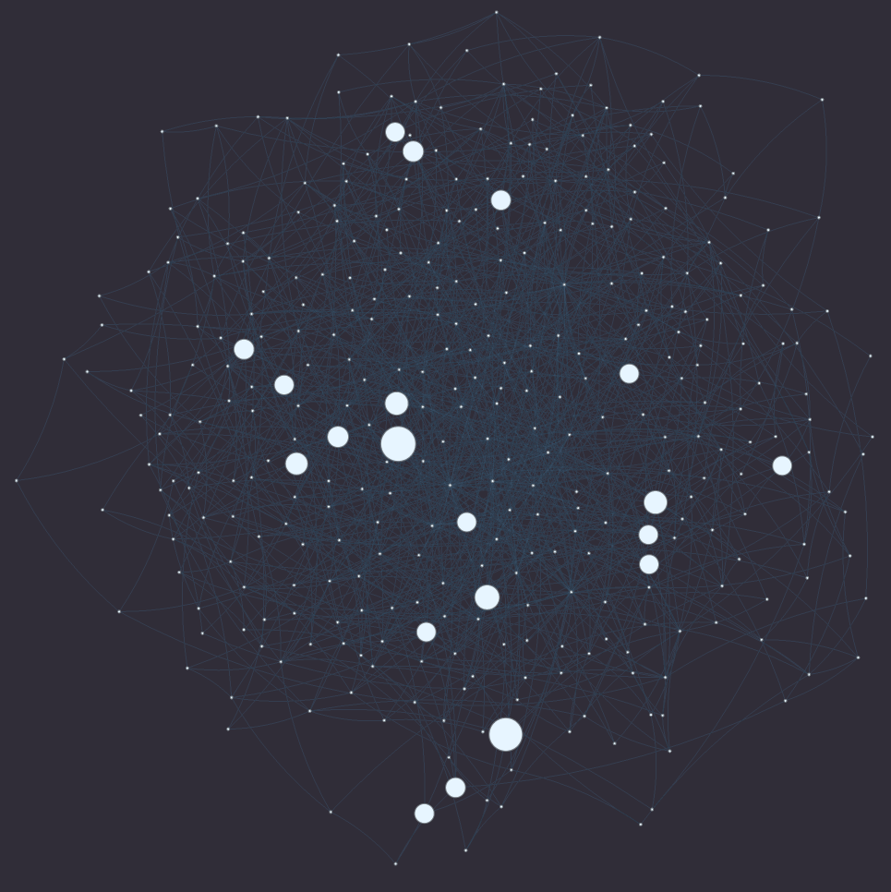
In 2009, Sina Weibo
– a Twitter-like platform in China – had:
~1.7M users,
~300K original posts,
~24M retweets*
Influencer
User
Retweet
*Retweet: when someone republishes or forwards a post to their own followers
Notes:
In 2009, Sina Weibo – a Twitter-like platform in China – had over 1.7 million users who reposted MILLIONS OF messages. In this network, a user might post an original message to share with their network, or might repost – meaning that they republish or forward a post from someone else to their own followers. We refer to reposts as a “retweet” throughout the presentation. Most of these retweets originated with a few “influential” users, whose original messages were retweeted many times. This graph displays a subset of the Sina Weibo network, where each dot – or node – represents a user and each line between the nodes – or edge – represents a retweet. The different node sizes represent user influence
FROM INFECTOR PAPER (FYI)
We examined this question in the diffusion cascades of the Weibo dataset, a network consisting of more than 1.7 million nodes and 0.4 billion edges, accompanied by a set of 300,000 retweet cascades spanning 3 years of recordings. The network is retrieved at the final month of these 3 years. The diffusion cascades are formed by gathering the past 1,000 tweets of each node in the network, resulting in a retweet network of over 24M connections. The original posts in these tweets represent the start of a cascade, and any tweet with the same content, that is not an original post and is preceded by the initial tweet, is considered a retweet. We should underline here that the original post is not defined based on time precedence, we know which tweet is the original post because it is the only tweet of a given content that is not marked as a retweet

Slide 4
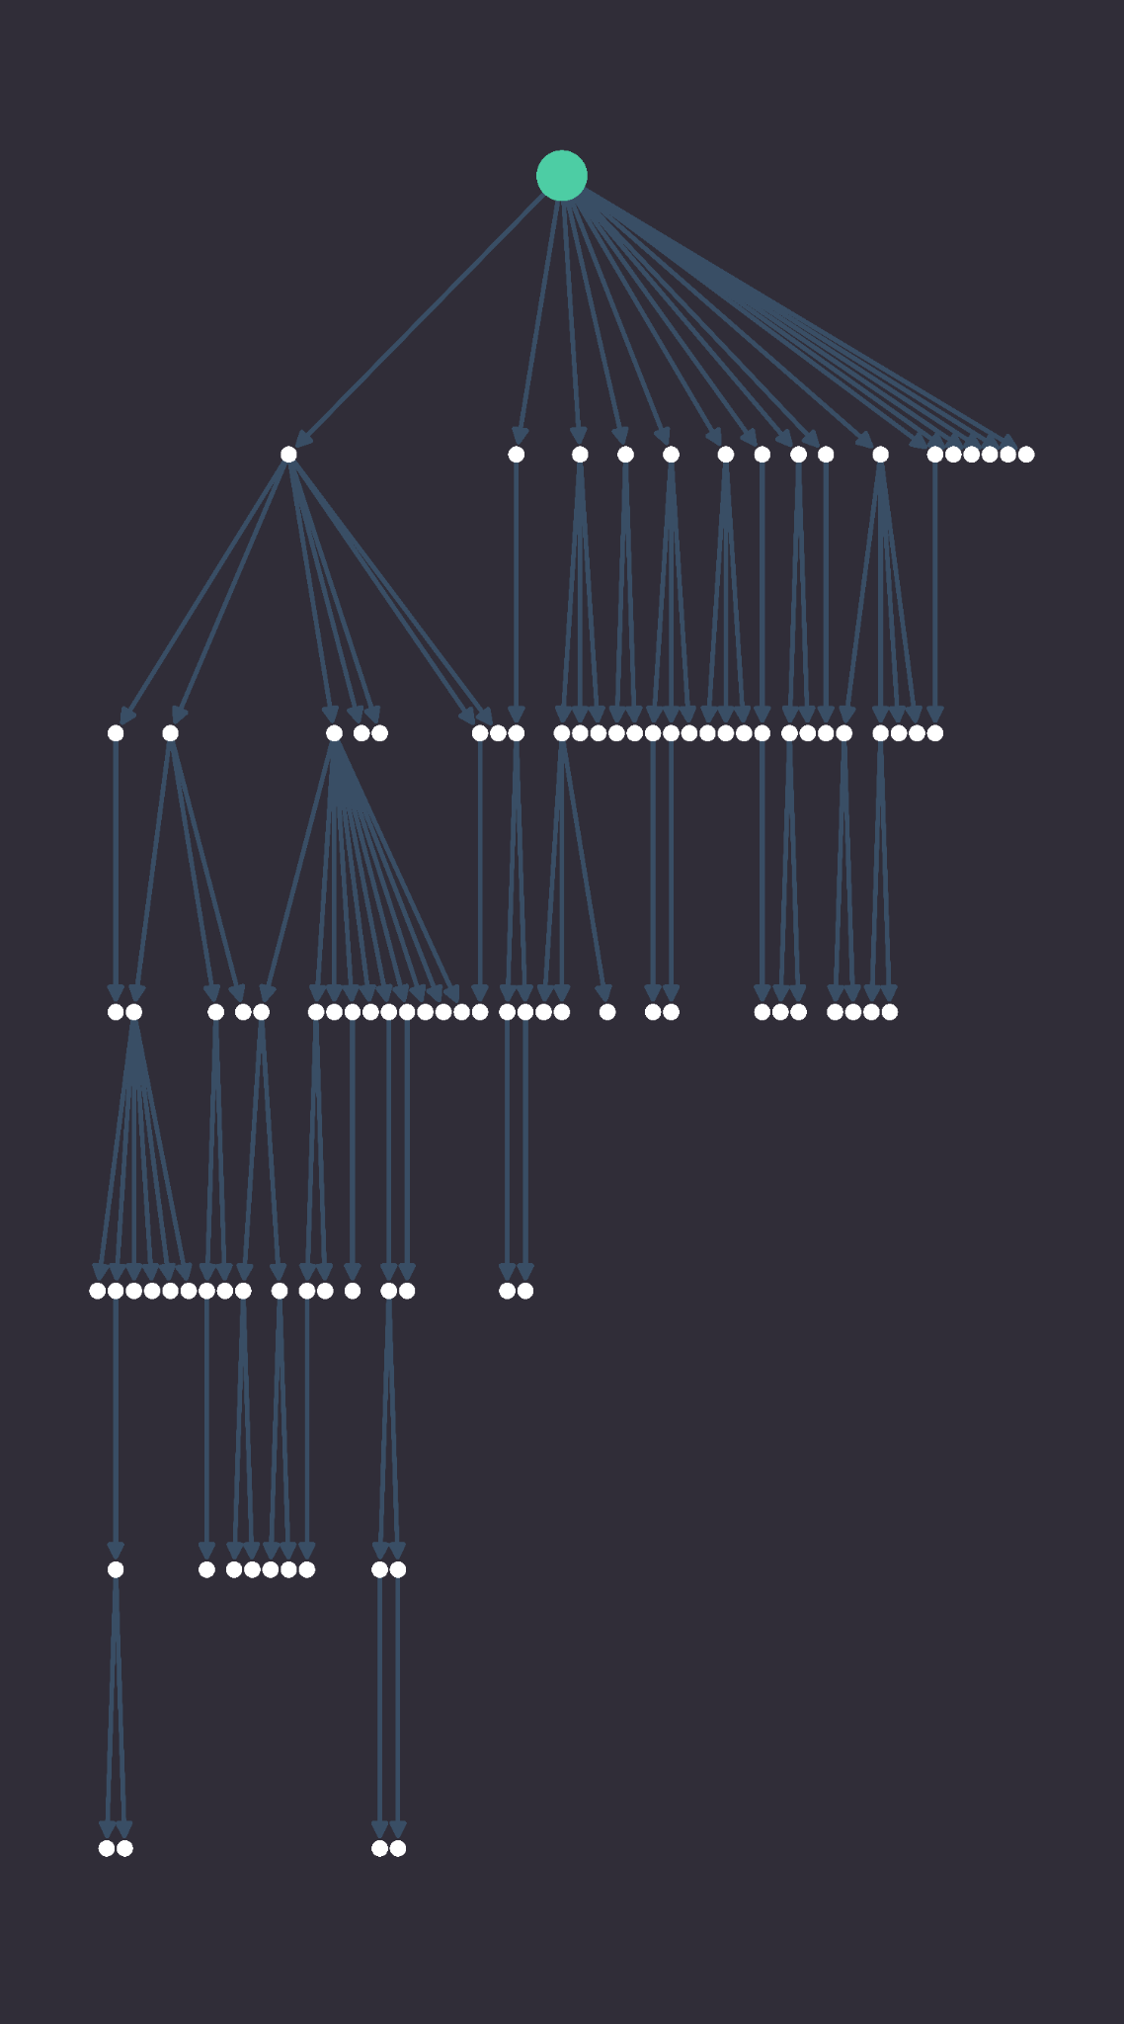
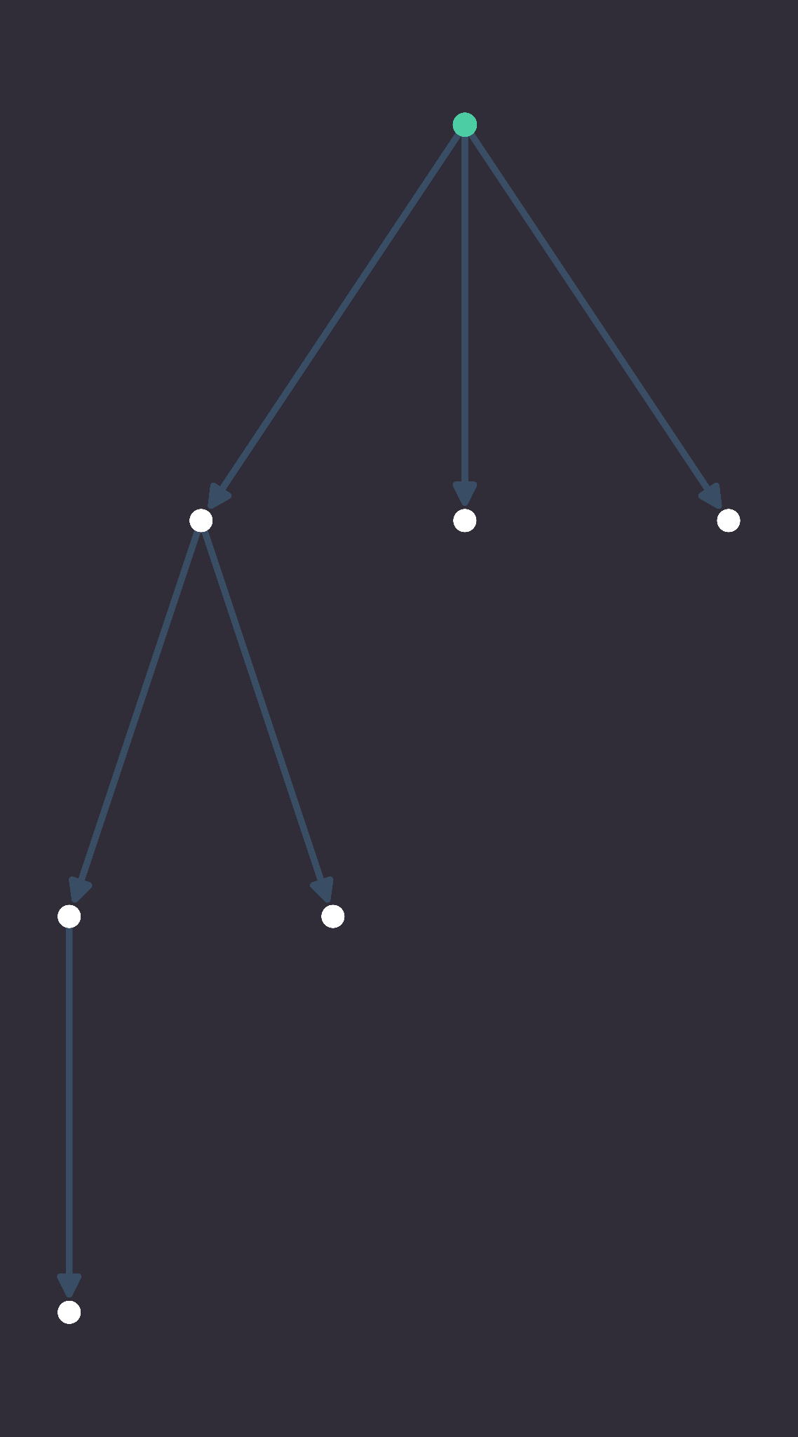
Cascades
103 retweets
6 retweets
Influencer
Retweeter
Retweet
Notes:
Some influencers start huge chains of retweeting, where their message is retweeted over and over. This is called a cascade. The largest cascade in this Sina Weibo network is over 50,000 retweets long. The larger structure on the left is not that large, but is an example of someone that seems to have greater influence than the individual who started the tiny chain on the right

Slide 5
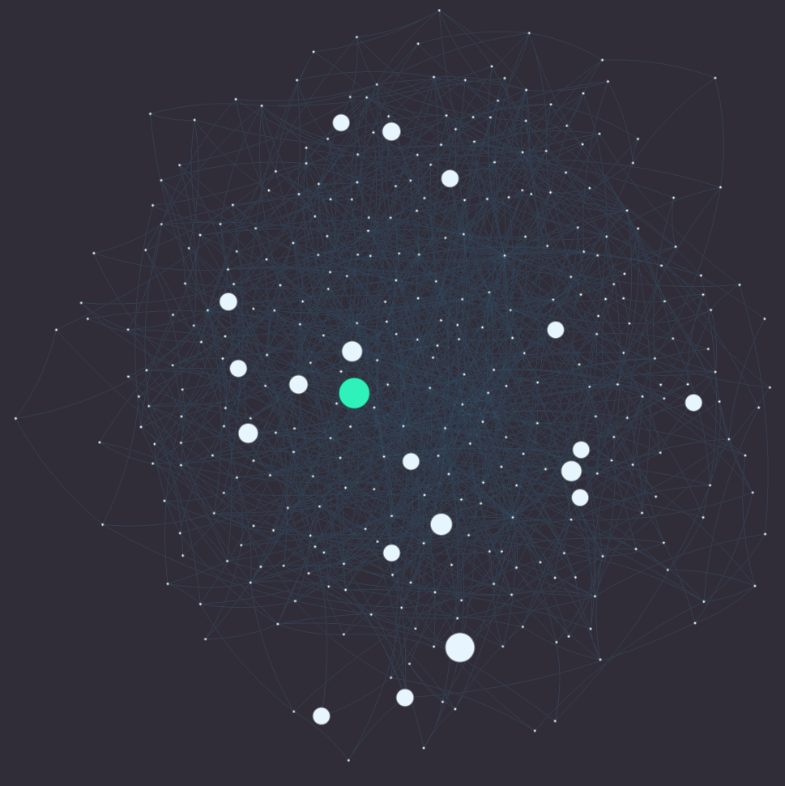
Influence maximization (IM)
Candidate influencer
Influencer with max information spread
Notes:
Influence maximization algorithms – or IM algorithms – help us trigger these massive cascades to spread our message, by finding the set of influencers that maximize information spread in a network.

Slide 6
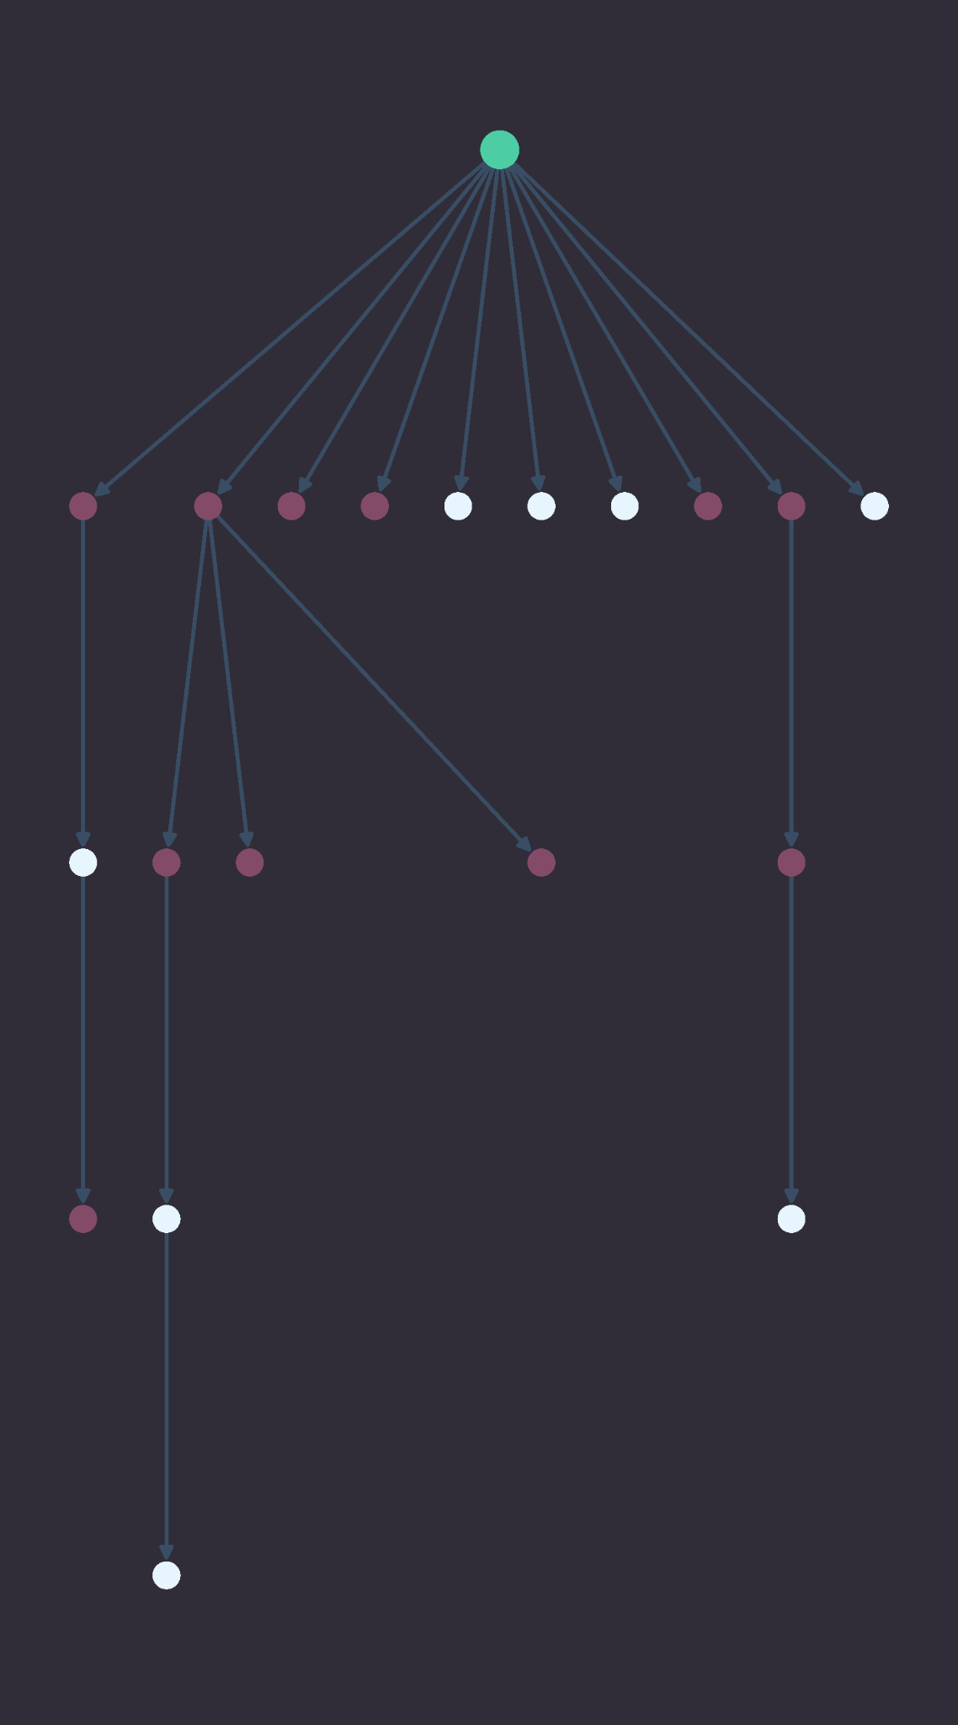
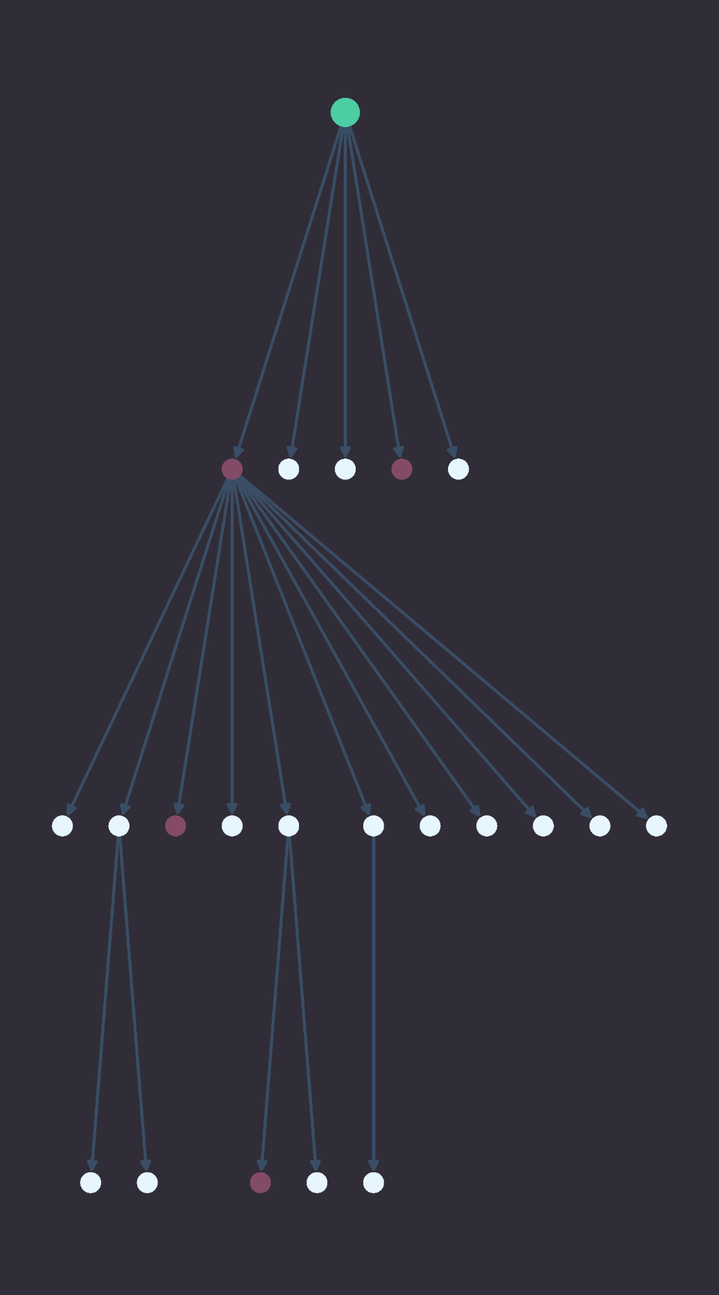
20 retweets
45% Male, 55% Female
21 retweets
82% Male, 18% Female
Varying cascade distributions
Influencer
Male user
Female user
Notes:
Some influencers share information with many different people, who might represent a diversity of genders, classes, races, ethnicities, et cetera. Others might share information just as widely, but only with a certain group. These cascades are around the same size, however have a different distribution of male to female users. The one on the left has about 45% male users who were influenced and the one on the right has about 82% male.

Slide 7
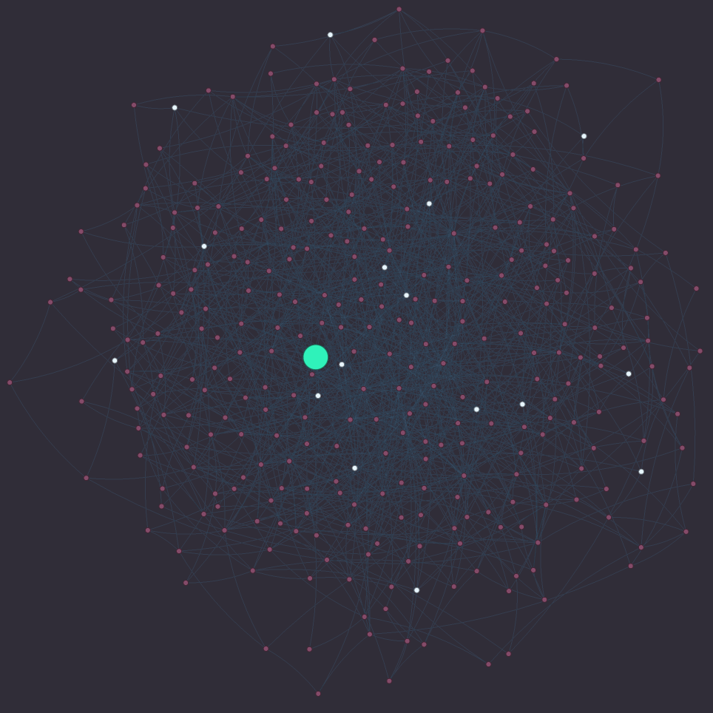
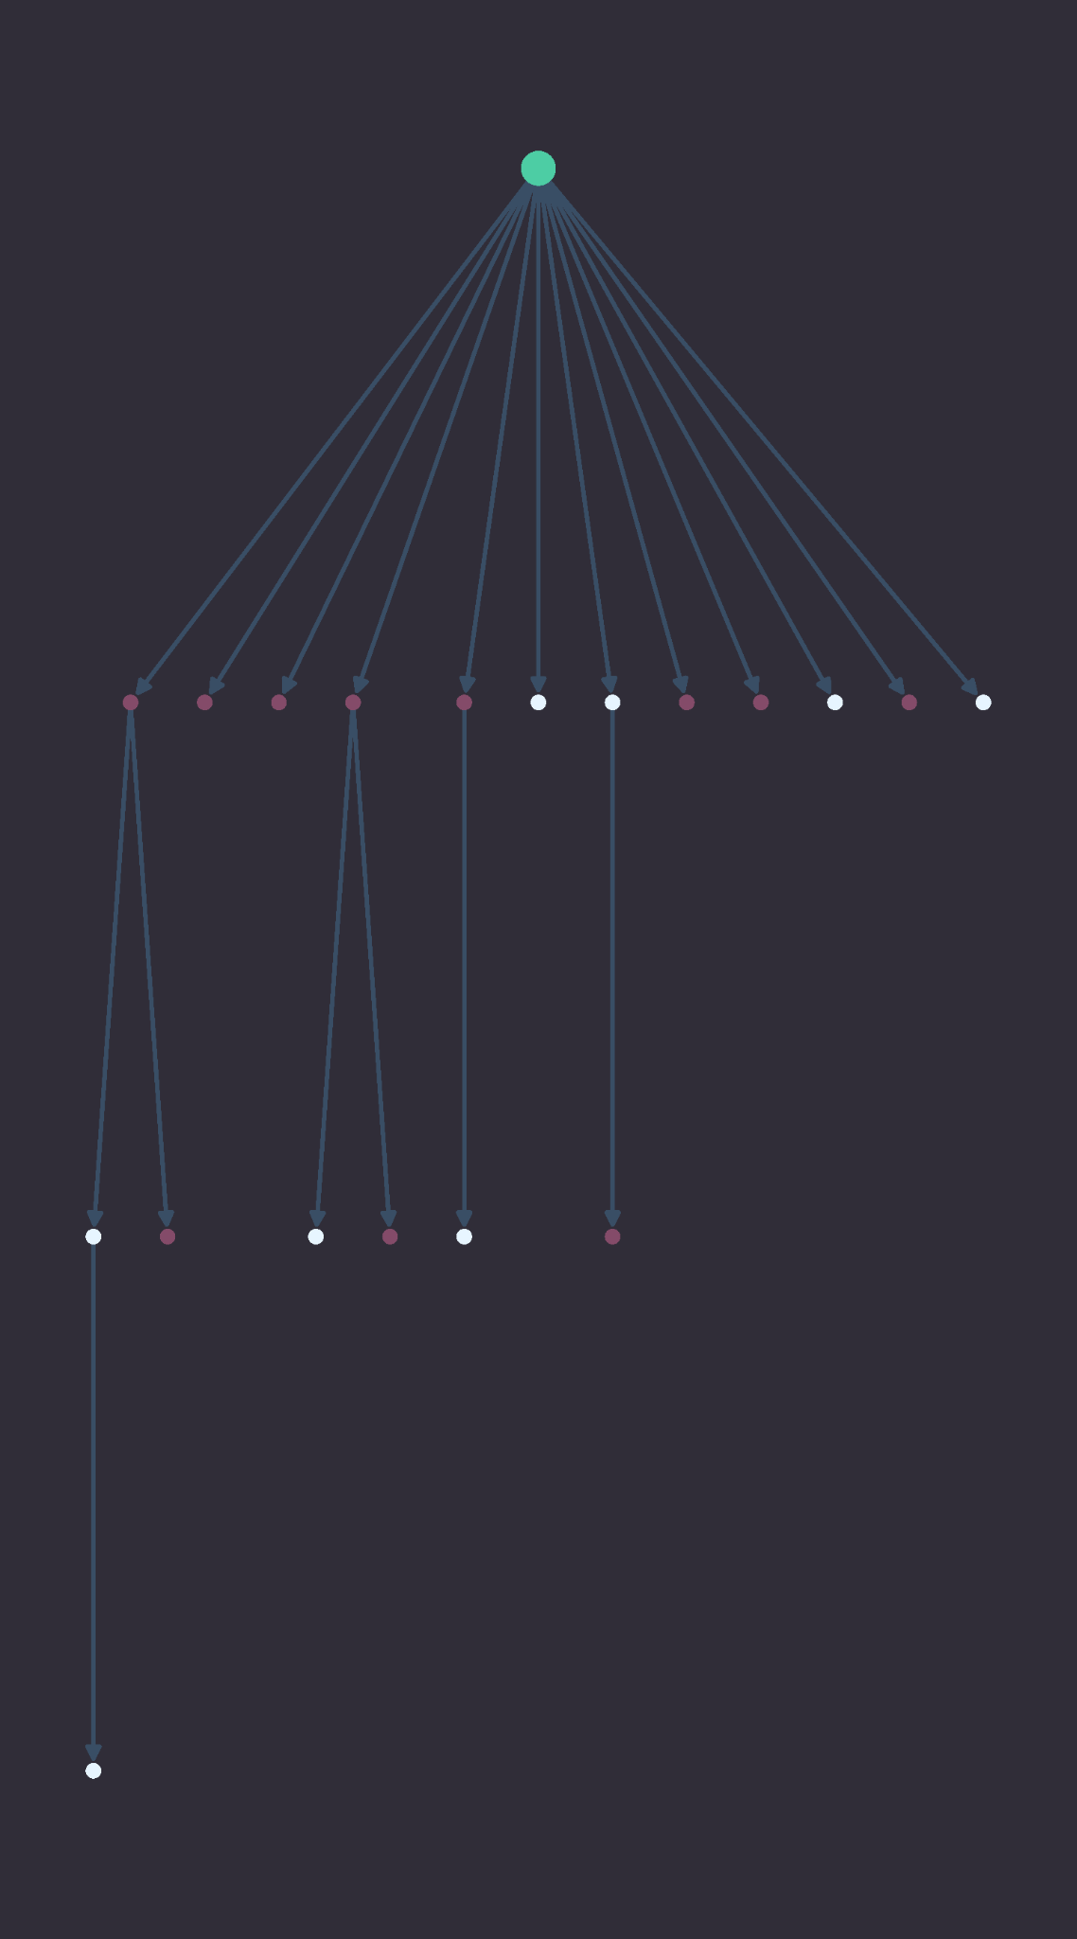
Fair influence maximization
Influencer
Network
45% M,
55% F
45% M,
55% F
Influencer
Male user
Female user
Notes:
One possible definition of fairness could compare the cascade distribution and that of the broader network. If the distribution of the cascade initiated by an influencer is similar to that of the broader network, we might think of this as “fair” information spread. More “fair” influencers tend to start fairer cascades. This definition of fairness is similar to the concept of demographic parity.

Slide 8
Can we optimize for fairness and influence with machine learning techniques?
Notes:
Now I’ll hand it off to Sophia who can share details on our analytical solution
—
What makes this work stand out in the influence maximization literature is its use of machine learning techniques to solve this problem.

Slide 9
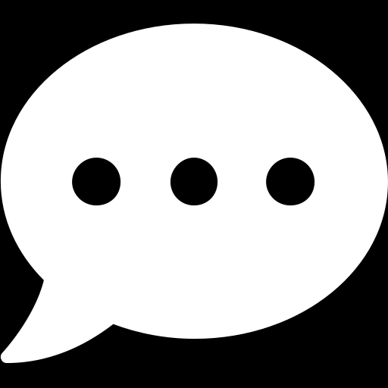
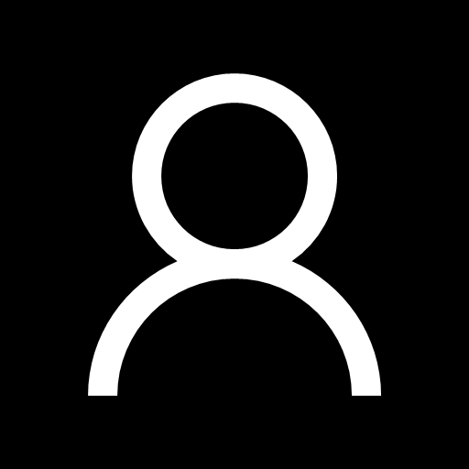
Components of an influence maximization algorithm
Network graph
Budget
Influence model
Optimization framework
Users
Content
Network
Retweet
Notes:
But to give you all a bit more context, most influence maximization approaches can be framed with these 4 components – You first need a dataset that can be modeled as a graph network
Second, you need a budget to determine how many influencers to select
Third, you need to model how influence actually spreads in the network
And finally, you need to have an optimization framework for selecting the top influencers
We’ll go through our analytical solution with this framing in mind to understand how the work we’re replicating applies these components.
—-
Mathy definition:
Given a network with n nodes and given a “spreading” or propagation process on that network, choose a “seed set” S of size k < n to maximize the number of nodes in the network that are ultimately influenced.

Slide 10
Components of an influence maximization algorithm
Network graph
Budget
Influence model
Optimization framework
Notes:
As Alissa showed, we are interested in exploring how influence and fairness are spread in this network of retweets.

Slide 11
Components of an influence maximization algorithm
Network graph
Budget
Influence model
Optimization framework
Number of seed users
1 2 3 k
. . .
Fairness threshold
Default
Fair
Notes:
In terms of a budget, we are looking for a subset of users whose influence will reach the maximum number of users in the network.
And this is where we also incorporate fairness. Our objective function in the algorithm enables us to set a threshold for prioritizing fairness in the spread of information. The idea is that lowering the threshold will default to maximizing by just influence on its own.

Slide 12
Components of an influence maximization algorithm
Network graph
Budget
Influence model
Optimization framework
Convert network to bipartite graph to model the spread of influence
Complexity of building data O(c⋅n⋅(n-1)/2) vs. O(c⋅n)
Notes:
To model the spread of influence – we are going to represent it as a probability that a user will appear in a cascade started by an influencer. Since we’re only interested in this binary condition that a user could or could not be influenced, well flatten this retweet cascade on the left and convert it into a bipartite graph, where we have just the influencers on one side, and the rest of the Weibo users on the other side, and the edge weight between them represents the probability of being influenced. And by reducing the network in this way, we also obtain some computational savings by not requiring graph traversals to model the spread of information which are quite expensive to implement at scale.

Slide 13
Components of an influence maximization algorithm
Network graph
Budget
Influence model
Optimization framework
Obtain influence probabilities between influencers and target users
p_{1,1}
p_{1,2}
p_{1,3}
p_{1,4}
p_{1,5}
Notes:
To predict these influence probabilities, we’ll use a technique in machine learning called representation learning, which we’ll apply to automatically associate influence and fairness magnitudes with certain users, based on how often they’re seen in the training data.
These learned influencer and target embeddings are combined to obtain our influence probabilities.

Slide 14
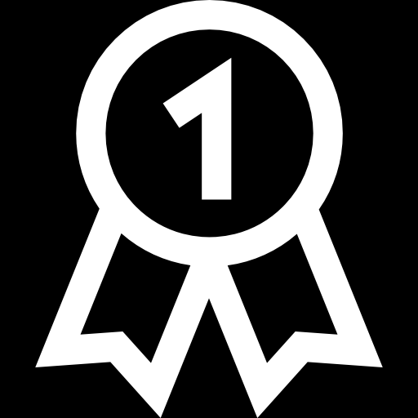
Components of an influence maximization algorithm
Network graph
Budget
Influence model
Optimization framework
Rank seeds that maximize cumulative influence probabilities, remove, and repeat
1
2
Time complexity O(k⋅|I|⋅|V|⋅log|V|)
Notes:
In the last step of our analytical solution, well obtain the most influential influencers by ranking their cumulative probabilities across the network. Pick the user that increases the current influence as much as possible.
Once we find this top influencer, we remove their target users from the network, and repeat this process until we have the number we set aside in our budget.
And so we’ve reached the end of the algorithm, and the original research team claims that this will result in a set of influencers that not only maximize the total number of users reached, but that also by incorporating fairness scores into the training process, the spread of information will also be fairly distributed across the network. And so how did replication work in practice? David will share how we approached recreating their work and some of the initial explorations.

Slide 15
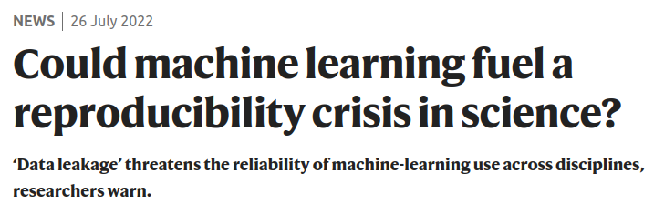
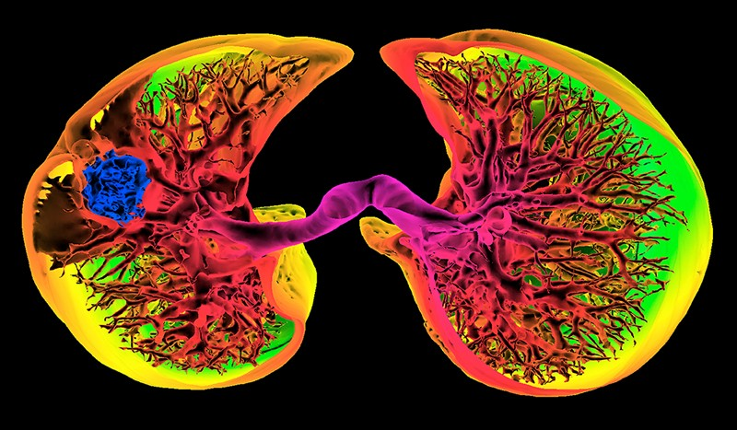

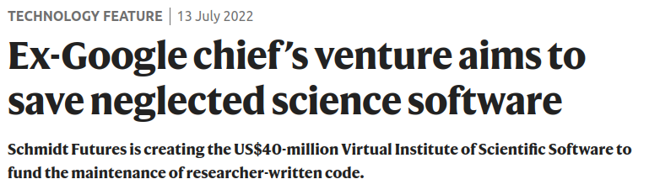
Why replication matters
Validates research
Ensures that results are accurate
Furthers scientific understanding
Notes:
Images from: Could machine learning fuel a reproducibility crisis in science?; Ex-Google chief’s venture aims to save neglected science software
Additionally, replication helps further scientific understanding, as a consensus develops in a given domain when external parties are able to successfully validate previous research.

Slide 16

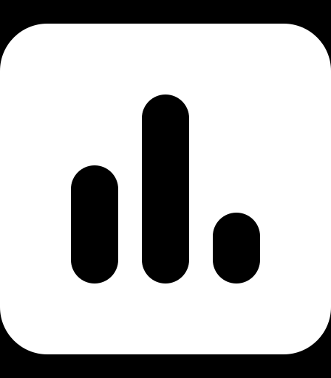
Two models to compare
Fairness-Based Participant Sampling (FPS)
Fairness As Context (FAC)
Challenges
Access to data and research team
Compute resource limitations
Dependency management
Code readability
Debugging
Model #1
FPS
Model #2
FAC
Notes:
We also faced several debugging challenges that the original team may or may not have faced.

Slide 17
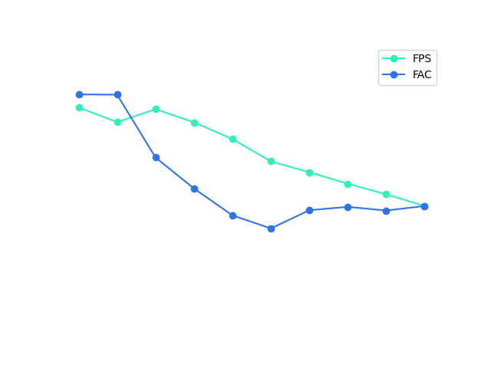
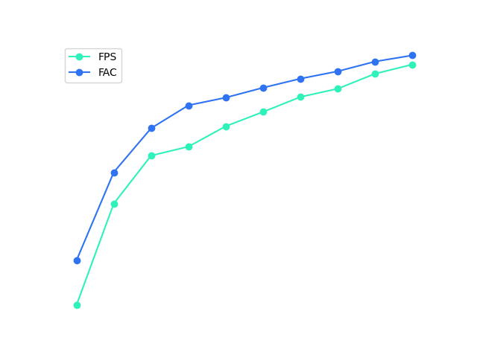
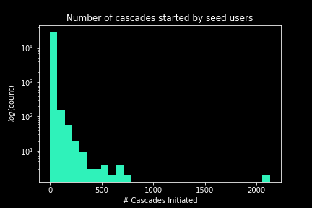
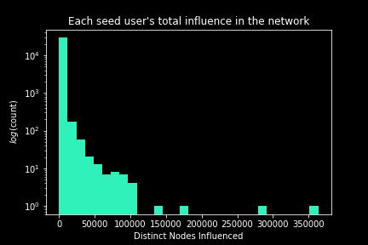
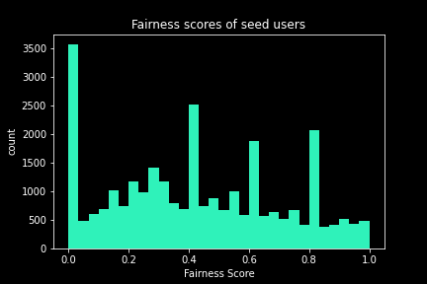
Measuring
fairness and influence
Notes:
Here are the initial results – here’s what we produced from the process. It is suggestive that influence increases with number of seed users and fairness remains somewhat stable within a band of values
There’s still work to do to verify the paper’s results
Also bring up scalability – We’re able to run this locally, more scalable with other solutions
Key Points:
Mention scalability (we probably couldn’t have run other processes on one local machine)
Mention that these results trend with what paper results were, but we’d need to access the exact visualization code they used to be able to see if results aligned with the results in the paper
Next, I’ll pass it over to Autumn to discuss the ethics involved in our project.

Slide 18
Why does fair information spread matter?
Notes:
Fair Information Spread, Ethically?

Slide 19
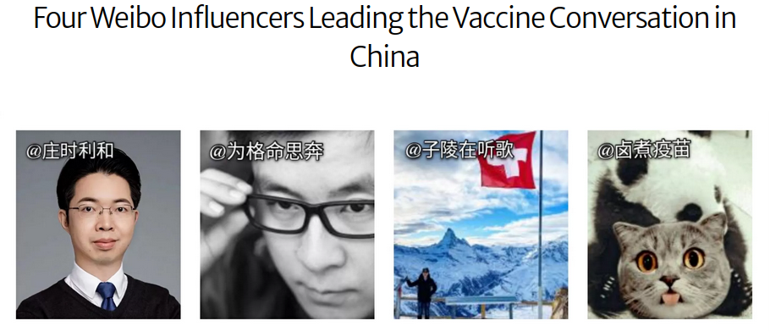
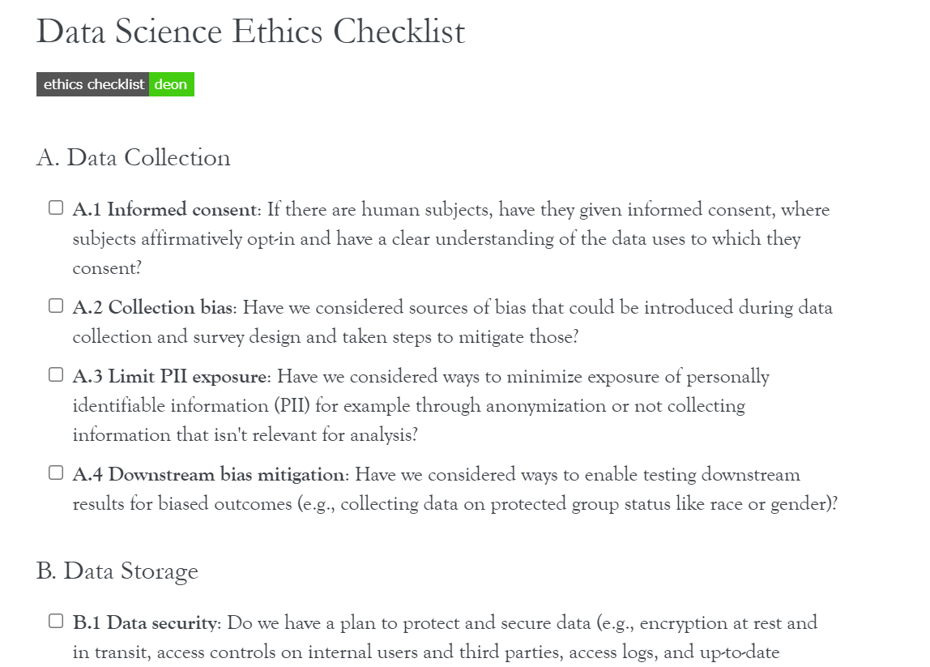
Fair information spread
Reduce Discriminatory Outcomes
Applies to any message: an ad, call for donations, critical public health information….
Ethical analysis
Tools
Deon Command Line Checklist
Consequence Scanning
Important considerations
Additional attributes
Other definitions of fairness
Intersectionality
Exclusion
Notes:
Fair information spread is crucial. Fairness measures are included in machine learning algorithms to ultimately reduce discriminatory outcomes. In influence maximization models, regardless of the type of message, it is important to reduce harms by ensuring that a message is spread ethically with respect to sensitive attributes within a network such that all groups are equally notified.
A large component of this project focused on incorporating our learnings from MIDS courses centered on ethics and privacy. We utilized two tools to accomplish this: the Deon Checklist and Consequences Scanning
Our analysis allowed us to ensure we followed best practices. We identified areas of improvement regarding privacy pertaining to retaining user data and additional use of this data beyond this project.
Reflecting on our work, it is important to note that fairness has several definitions mathematically and ethically. We have held to the definition of demographic parity.
Within this project we only looked at gender. We also only considered two categories of gender (male or female) and ignored information spread amongst people who identify in other ways.
Other areas of related research should expand to consider intersectionality, or how these different attributes might combine. We also might consider other definitions of fairness. Demographic parity might not be the best measurement in every application.

Slide 20
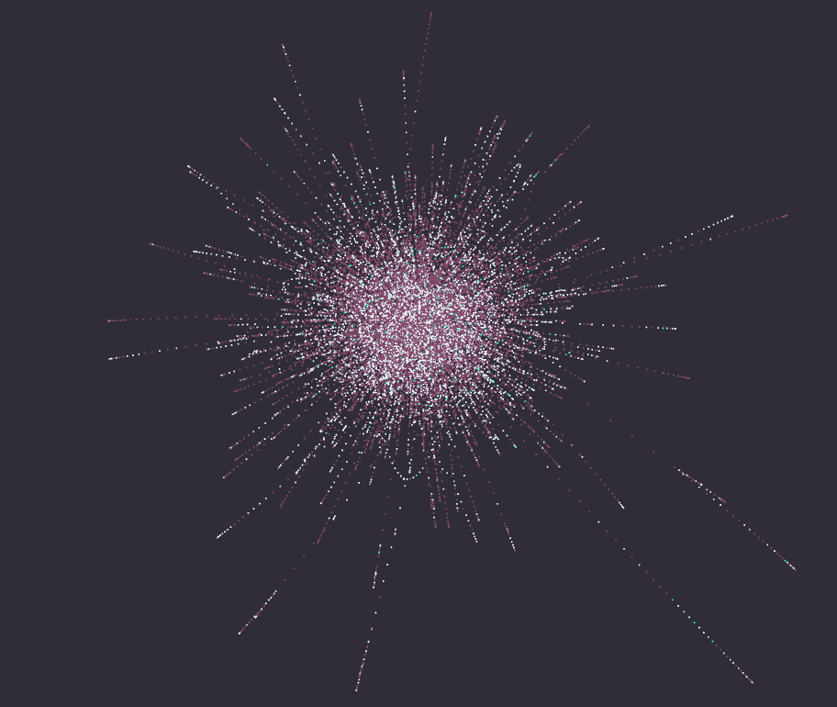
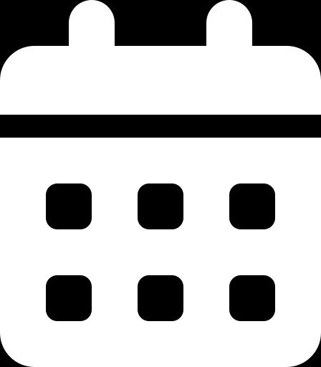
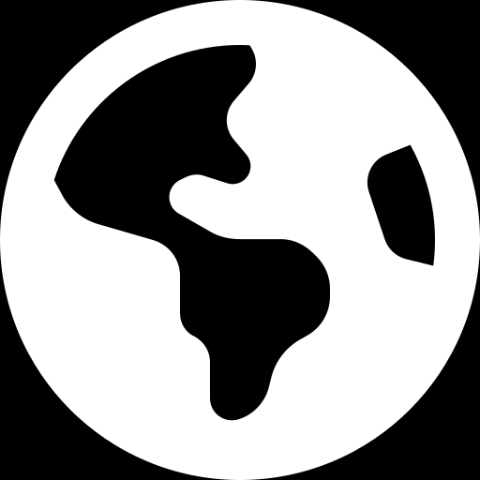
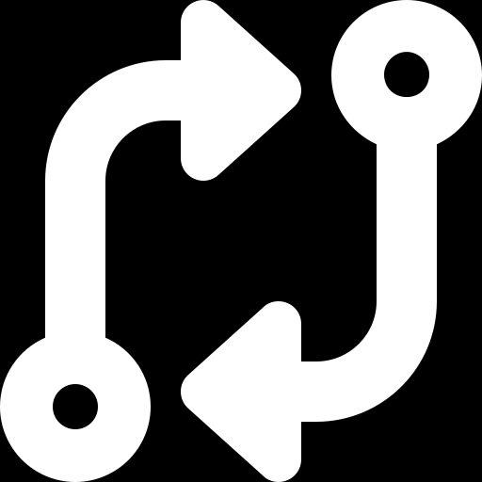
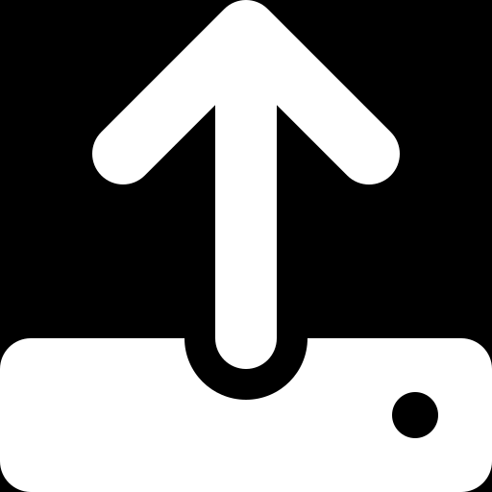
What’s next?
Keep in touch
Living resource hub
Website with our story
Ischool Website
Incorporate new features
Compare results on new datasets
Demographic model analysis, visualization
Publish findings
Notes:
Our goal was to replicate and improve research that incorporates fairness IM algorithms. We have successfully replicated the work.
The two models studied in our research perform well compared to current cutting-edge IM models.
We also incorporated ethical frameworks we learned from our MIDS courses into our research in line with regulations and best practices to maintain privacy and fair use of user data.
Future areas of work should focus on analyzing alternative definitions of fairness within our IM models.
We plan to incorporate additional sensitive attributes of user profiles such as a user’s location or topics of retweets to understand how the fair spread of information in social networks can be impacted.
We will continue to use the Sina Weibo dataset for analysis but will also expand our work to study other social network datasets. Ultimately, we strive to publish our findings as the researchers that we are.
For those interested in diving deeper, our work can be found at the three links on the screen: our public Github repo, our capstone project page, or our project website which includes initial visualizations. I will now open for questions - thank you!

Slide 21
Thank you!

Slide 22


Users
Content
Network
Diffusion
Notes:
Most influence maximization problems can be framed with these 4 components – You first need a dataset that can be modeled as a graph network
Second, you need a budget to determine how many influencers to select
Third, you need to model how influence actually spreads in the network
And finally, you need to have an optimization framework for selecting the top influencers
We’ll go through our algorithmic solution with this framing in mind to understand how the work we’re replicating applies these components.
—-
Mathy definition:
Given a network with n nodes and given a “spreading” or propagation process on that network, choose a “seed set” S of size k < n to maximize the number of nodes in the network that are ultimately influenced.

Slide 23
Maximizing Influence and Fairness in Social Networks at Scale
TEAM INFLUENCERS
David Peletz
Autumn Rains
Sophia Skowronski
Alissa Stover
RESEARCH
Alberto Todeschini
Puya Vahabi
Notes:
Hello, we are Team Influencers

Slide 24

Cascade influence
Notes:
We’ve been building our website through Github using Pages. On the screen you’ll see a brief screen grab of a rough draft.
We are planning to have the site primarily include our final presentation but it will also include additional links for users to explore additional graphs.
We are conducting user testing this week to gather feedback.

Slide 25
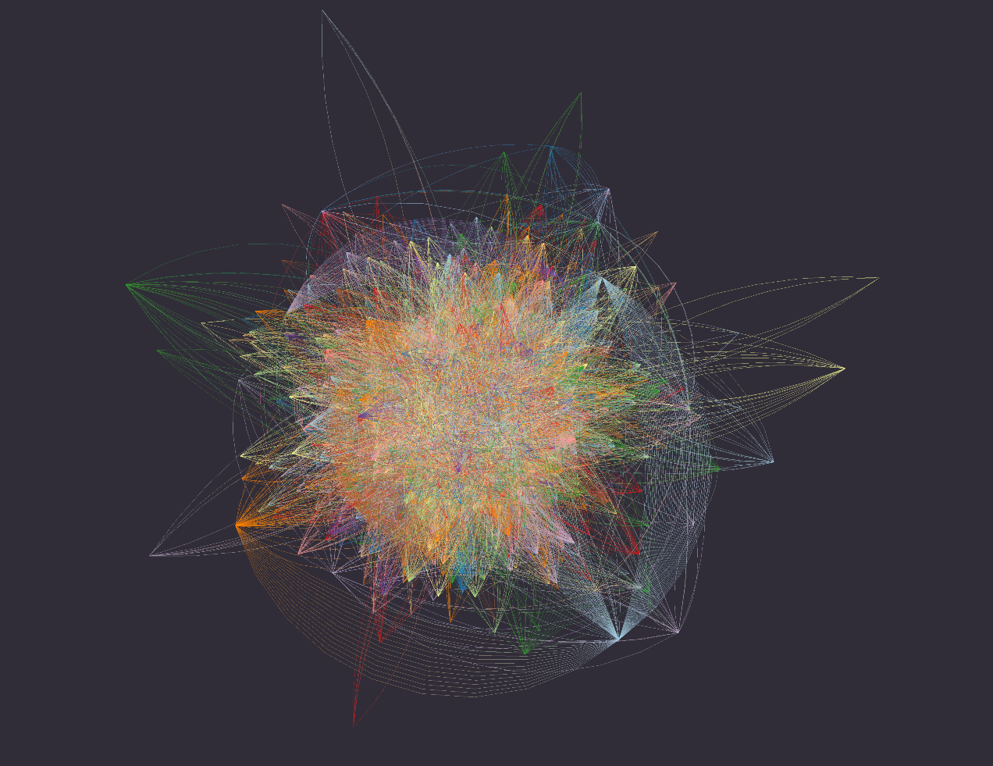
Thank you!
Notes:
Alissa

Slide 26
Influencers selected
ID | % Users | Fairness
A | 29 | 79
B | 23 | 76
C | 14 | 56
D | 11 | 91
E | 9 | 90
Influence
ID | % Users | Fairness
F | 8 | 66
G | 8 | 49
C | 14 | 56
B | 23 | 76
A | 29 | 79
Fairness approach #1
ID | % Users | Fairness
D | 11 | 91
C | 14 | 56
B | 23 | 76
A | 29 | 79
H | 8 | 47
Fairness approach #2

Slide 27
Results
Notes:
So now I’ll hand it off to David to give more context for our approach

Slide 28
Maximizing Influence and Fairness in Social Networks
TEAM INFLUENCERS
David Peletz
Autumn Rains
Sophia Skowronski
Alissa Stover
RESEARCH
Alberto Todeschini
Puya Vahabi

Slide 29
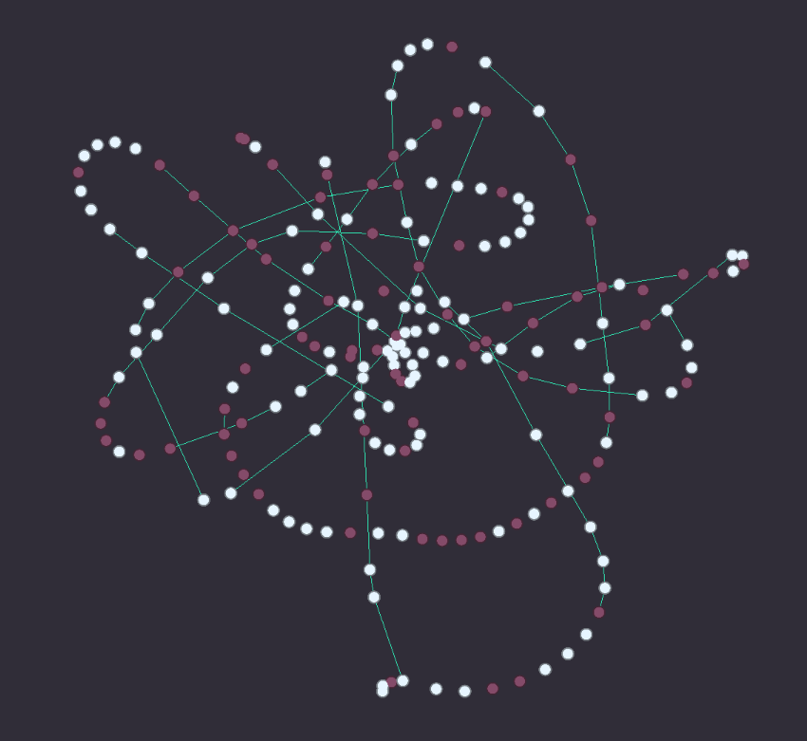
Maximizing Influence and Fairness in Social Networks
P2 & PROJECT UPDATE
July 12, 2022
RESEARCH TEAM INFLUENCERS
Alberto Todeschini Alissa, Autumn
Puya Vahabi David, Sophia
TEAM INFLUENCERS
Alissa Autumn
David Sophia

Slide 30
Maximizing Influence and Fairness in Social Networks
TEAM INFLUENCERS
David Peletz
Autumn Rains
Sophia Skowronski
Alissa Stover
RESEARCH
Alberto Todeschini
Puya Vahabi

Slide 31
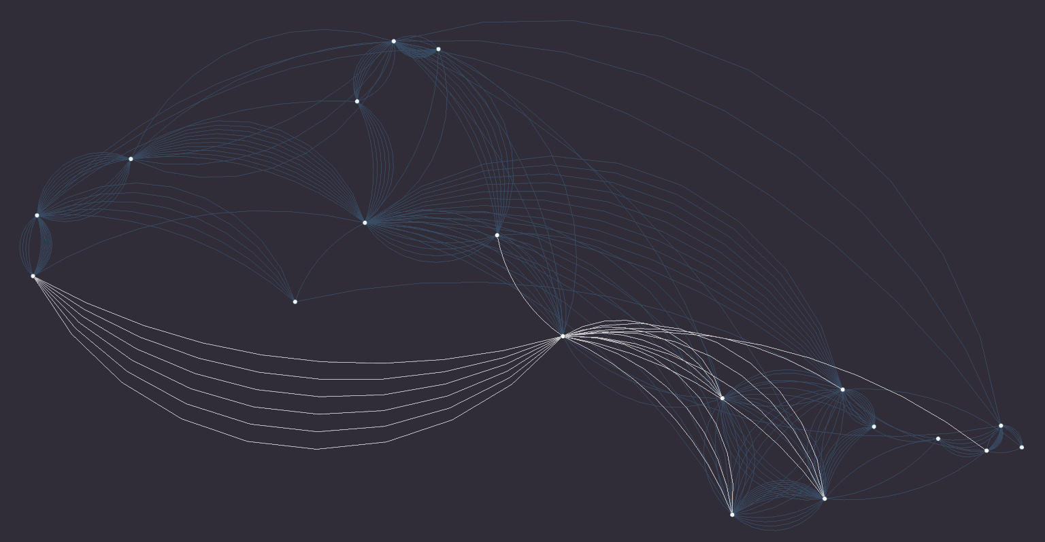
Maximizing Influence and Fairness in Social Networks
TEAM INFLUENCERS
David Peletz
Autumn Rains
Sophia Skowronski
Alissa Stover
RESEARCH
Alberto Todeschini
Puya Vahabi

Slide 32
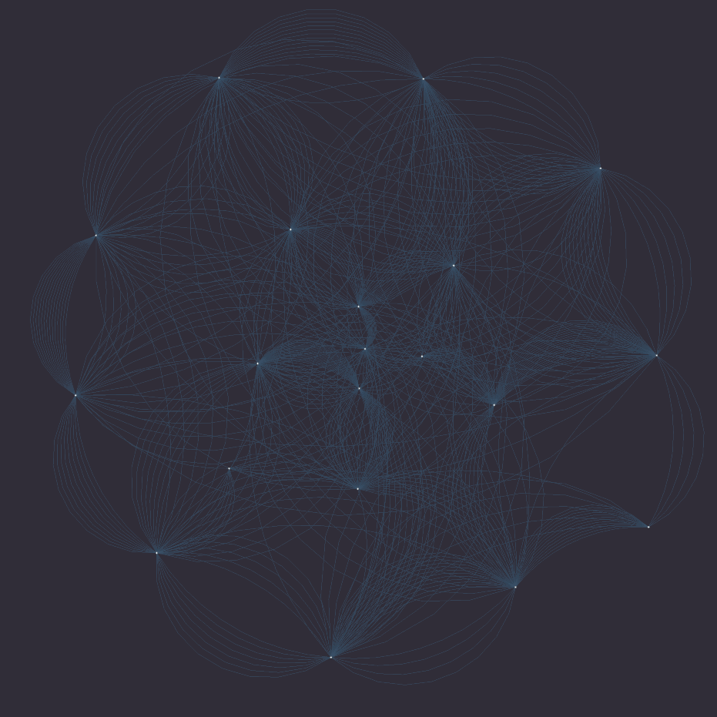
Maximizing Influence and Fairness in Social Networks
TEAM INFLUENCERS
David Peletz
Autumn Rains
Sophia Skowronski
Alissa Stover
RESEARCH
Alberto Todeschini
Puya Vahabi

Slide 33
What methods have been used to model influence in this way?

Slide 34
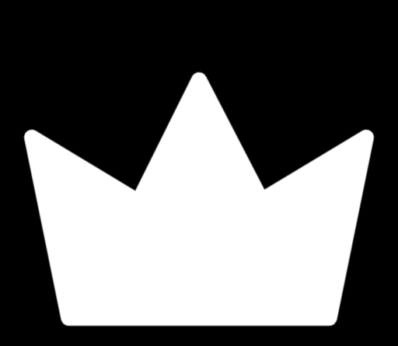
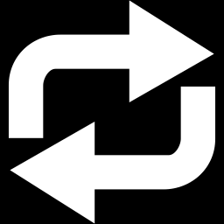
Components of an influence maximization algorithm
Network graph
Budget
Influence model
Optimization framework
Convert retweet propagation network to bipartite graph to model the spread of influence
?
Δt₂
Δt₃
?
Δt₅
?
Δt₄
Δt ₁
?
?
p_{s,t}
Diffusion probability p_{s,t} | The probability that the seed user will influence the target user
Complexity of building data O(c ⋅ n ⋅ (n-1) / 2) vs. O(c ⋅ n)
Notes:
For modeling the spread of influence – we are going to represent it as a probability that a user will appear in a cascade started by an influencer. This is called the diffusion probability.
We have a retweet graph on the left that shows how information propagates with each retweet, but since we are only interested in the binary condition that a user could or could not be influenced, We eliminate distance and reduce the edges into what is called a bipartite graph, where we have just the influencer users on one side, and the rest of the Weibo users on the other side, and edges connecting them with diffusion probabilities as edge weight.
Although we are removing network connectivity, we will incorporate information about their shared cascade in other ways.
—
Question: What cases would distance be relevant for influence modeling?
Framing our hypothesis another way: The central idea is that that an influencer’s strength lies in the cascades they initiate
NEED TO REVIEW – HOW NETWORK MIGHT BE RELEVANT FOR LINK PREDICTION OR NEXT EDGE PREDICTION
https://ojs.aaai.org/index.php/ICWSM/article/download/7319/7173/10549
Diffusion models (modeling directly on a network graph) have a hard time modeling higher order correlations.
and we are assuming that it is independent of distance between the two users in the graph itself.
Question: Computational complexity?
This actually results in a large computational savings
Building the context between two nodes on the retweet network would have O(C*N(N-1)/2) complexity versus O(C*N) complexity for the bipartite representation in creating the training examples
The previous process requires the creation of the propagation network, meaning going through every node. in the cascade and iterating over the subsequent nodes to search for a directed edge in the network. This has a complexity of O ( c( ̄n( ̄n − 1)/2)), where c is the number of cascades and ̄n is the average cascade size. Given that the average size of a cascade can surpass 60 nodes, it is a very time consuming for a scalable IM algorithm.
The node- context creation has a complexity of O(cn), which is linear to the cascade’s size and does not require searching in the underlying network.

Slide 35
Components of an influence maximization algorithm
Network graph
Budget
Influence model
Optimization framework
Representation learning with cascade context to infer diffusion probabilities between seed and target users
p_{1,1}
p_{1,2}
p_{1,3}
p_{1,4}
p_{1,5}
Cascade context | Number of participating users and its fairness score [seed user, target user, # usrs, fair score]
Notes:
The next step is to predict these diffusion probabilities between a pair of users, and so we’ll use a technique in machine learning called representation learning, which is used for automatically discovering representations from data.
These learned representations are generated after training on all pairings between influencers and users that are seen in cascades, called the cascade context, where we feed in information about the cascade size (where more users means more influence) and fairness score so our model can learn about these two features associated with each user pair.
This results in influencer/user embeddings, which are then combined at the end of our model pipeline to obtain diffusion probabilities.
— Question: Details on learning pipeline? - First layer is noise contrastive estimation – unsupervised method where network learns how often the users occur together - Second layer is supervised based on cascade length - Third layer is based on fairness scores
Question: Details on how diffusion probabilities are obtained?
Separate matrix embeddings for our source and target users, which we combine via matrix multiplication to obtain the probabilities.
Question: What other methods are used for influence modeling?
To our knowledge, this research is one of the first to leverage representation learning for modeling influence in a network.
Influence Embeddings – Inf2Vec
Diffusion Models
The degree to which influence maximization applies to real policy decisions, such as which customers to market to or which people to immunize, depends almost entirely on whether the influence model is correctly specified.
If influence models are realistic and reflect our empirical understanding of influence diffusion, then social influence maximization will produce realistic optimal seed sets that create behavioural diffusion.
If influence models are misspecified, however, influence maximization will produce unrealistic and suboptimal seed sets.

Slide 36
Components of an influence maximization algorithm
Network graph
Budget
Influence model
Optimization framework
Rank top seeds that maximize influence spread, remove, & repeat
1
2
Influence spread | Number of users reached by a set of seed users
Sort influencer attributes
Time complexity O((I ⋅ N ⋅ log(N)) ⋅ (I ⋅ log(I)) ⋅ k)
Final seed set size, k

Slide 37
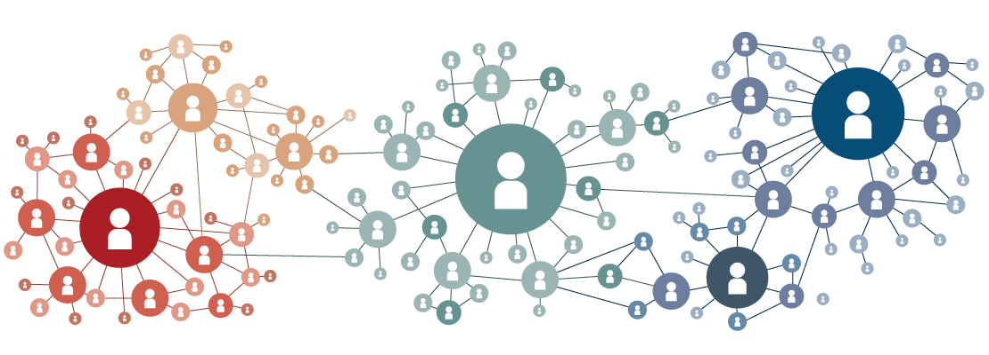
Maximizing Influence and Fairness in Social Networks
TEAM INFLUENCERS
RESEARCH
PROJECT UPDATE
Alissa
Autumn
David
Sophia
Alberto Todeschini
Puya Vahabi
July 12, 2022
Notes:
Autumn

Slide 38
Related work
Create simple table to compare approaches
Diffusion models
Picture
Assumptions
Issues
Influence embeddings
Picture
Assumptions
Issues
Us
Machine learning
We’re the best

Slide 39
ML pipeline

Slide 40
ML Pipeline
Combine evaluation and EDA of replication
Train / test split
We have separated the dataset in train and test cascades based on their time of occurrence. We keep the 18,652 diffusion cascades from the last month of recording as a test set and the 97,034 from the previous 11 months as a train set.
Hyperparameters
Oversampling of cascades with higher fairness scores
Etc.
Evaluation
Compute the number of distinct nodes influenced in the test diffusion cascades by the predicted seed set

Slide 41
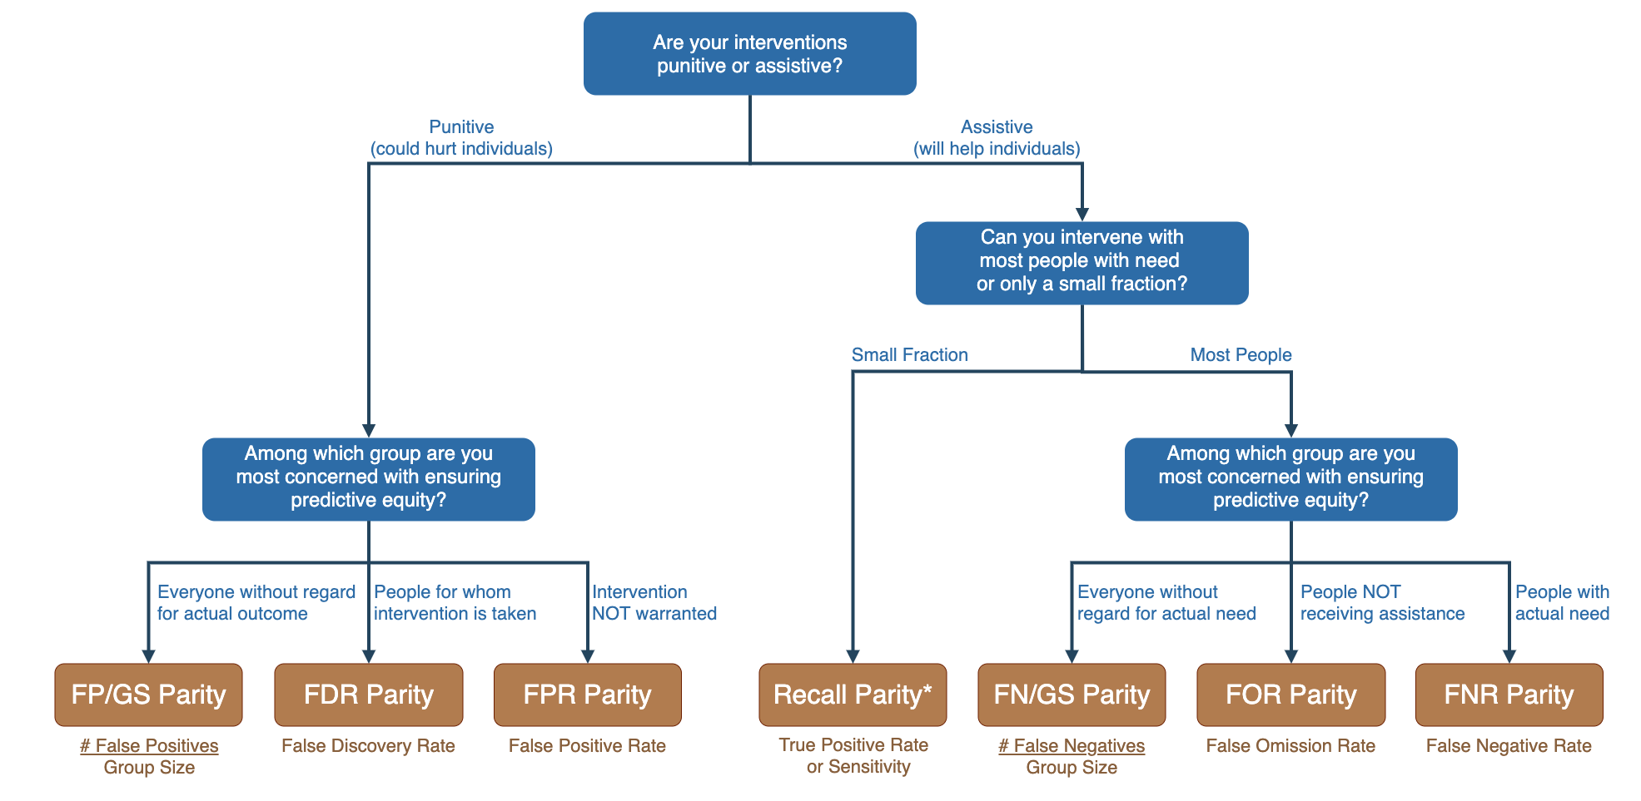
III
Ethical Considerations
Is this fair information spread?
Consider….
Which attributes are measured, and how
Intersectionality
Other definitions of fairness
Who is excluded from network
Including social actors
Image: http://www.datasciencepublicpolicy.org/our-work/tools-guides/aequitas/
Notes:
Alissa - We employed the deon command line checklist and a Consequences Scanning exercise to understand ethical considerations in the development of this algorithm. Our analysis is documented on our Github, but we wanted to raise one major ethical concern here - namely, that groups who might use this algorithm could apply it to their dataset or deploy it and consider that enough when it comes to fairness. However, ensuring that a message is spread amongst a group in proportion to its share in the broader population does not ensure that this information spread is “fair”. We need to consider which attributes we are not measuring - for example, in this project we only looked at gender. We also only considered two categories of gender (male or female) and ignored information spread amongst people who identify in other ways. We should also consider intersectionality, or how these different attributes might combine - for example, we might spread information only amongst affluent females, but not females with low incomes – in the current application we would not have measured this but it would be unfair in most scenarios. We also might consider other definitions of fairness. Demographic parity might not be the best measurement in each context. We also cannot share information beyond the network, which could unfairly exclude groups that are not part of it. For example, in the Sina Weibo context this might especially harm people from rural communities. Finally, we cannot approach fairness from a purely technical perspective and in any application should be including social actors. For example, is it fair to only consider who the information spreads to (and not who we select as influencers) – especially in a context where being an influencer can be a very lucrative endeavor? This would require contextual knowledge that we can’t know through a purely technical approach.

Slide 43
Narrative – Morgan feedback priority
Intro / Problem Statement - Shorten
Related Work - Here’s how other people solved this problem - PRESO #3
High level summary with references in appendix
Algorithm Solution
FPS / FAC walk through
Replication Results – Does this match what the paper stated - PRESO #3
Depends on if we hear from other researchers but might not be ready by presentation #2
Edge Cases? – TBD - PRESO #3
Ethical Considerations
Conclusions

Slide 44
Components of an influence maximization algorithm
Network graph
Budget
Influence model
Optimization framework
Representation learning with cascade context to infer diffusion probabilities between seed and target users
p₁
p₂
p₃
p₄
p₅
Cascade context | Number of participating users and its fairness score [seed user, target user, # usrs, fair score]
p₁
T
p₂
p₃
p₄
p₅
Notes:
To infer the diffusion probabilities between a pair of nodes, we use representation learning (unsupervised feature learning technique) to generate representations of seed and target users based on their shared cascade context, which includes information on number of users that participated in the cascade and fairness scores.
The resulting representations are combined to obtain diffusion probabilities.
To our knowledge, this research is one of the first to leverage representation learning for modeling influence in a network.
Question: Details on how diffusion probabilities are obtained?
Separate matrix embeddings for our source and target users, which we combine via matrix multiplication to obtain the probabilities.

Slide 45
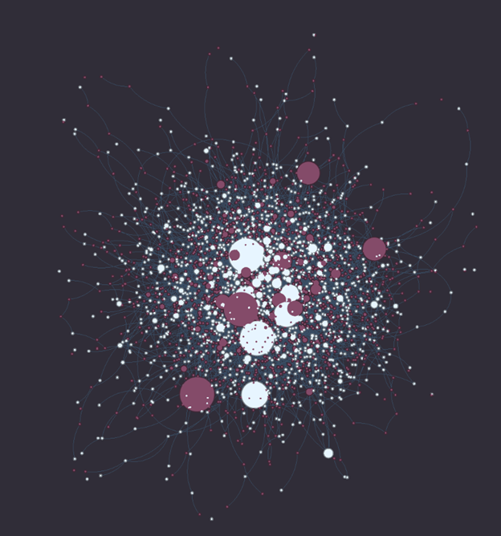
“Influence maximization” algorithms solve this problem
Finds the set of K influencers that maximize information spread in a network.
Notes:
To reframe our problem statement, how might we find the right influencers, who will be able to start these large cascades and share that message with the most people?
Influence maximization is an algorithmic solution to this problem. In influence maximization, we find the set of k influencers that maximize information spread in a network.

Slide 46
In 2009, Sina Weibo had:
~1.8M users,
~300K original posts
~24M retweets
Most of the posts originate with a few “influencers”, whose messages were retweeted many times.
Node (A)
Node (B)
Edge
Notes:
In 2009, Sina Weibo – a Twitter-like platform in China – had over 1.7 million users who retweeted MILLIONS OF messages. Most of these originated with a few “influential” users, whose original messages were retweeted many times. This graph displays a subset of the Sina Weibo network, where each dot – or node – represents a user and each line between the nodes – or edge – represents a retweet. The two colors of our nodes - red and light blue - represent 2 categories as a measure of diversity of people in the network. Let’s call the light color group A and the red color group B. Gender is one attribute we were able to measure in the Sina Weibo network so you can think of group A as male and group B as female, but you can also have other attributes - like age or location - and multiple categories within attributes.
FROM INFECTOR PAPER (FYI)
We examined this question in the diffusion cascades of the Weibo dataset, a network consisting of more than 1.7 million nodes and 0.4 billion edges, accompanied by a set of 300,000 retweet cascades spanning 3 years of recordings. The network is retrieved at the final month of these 3 years. The diffusion cascades are formed by gathering the past 1,000 tweets of each node in the network, resulting in a retweet network of over 24M connections. The original posts in these tweets represent the start of a cascade, and any tweet with the same content, that is not an original post and is preceded by the initial tweet, is considered a retweet. We should underline here that the original post is not defined based on time precedence, we know which tweet is the original post because it is the only tweet of a given content that is not marked as a retweet

Slide 47
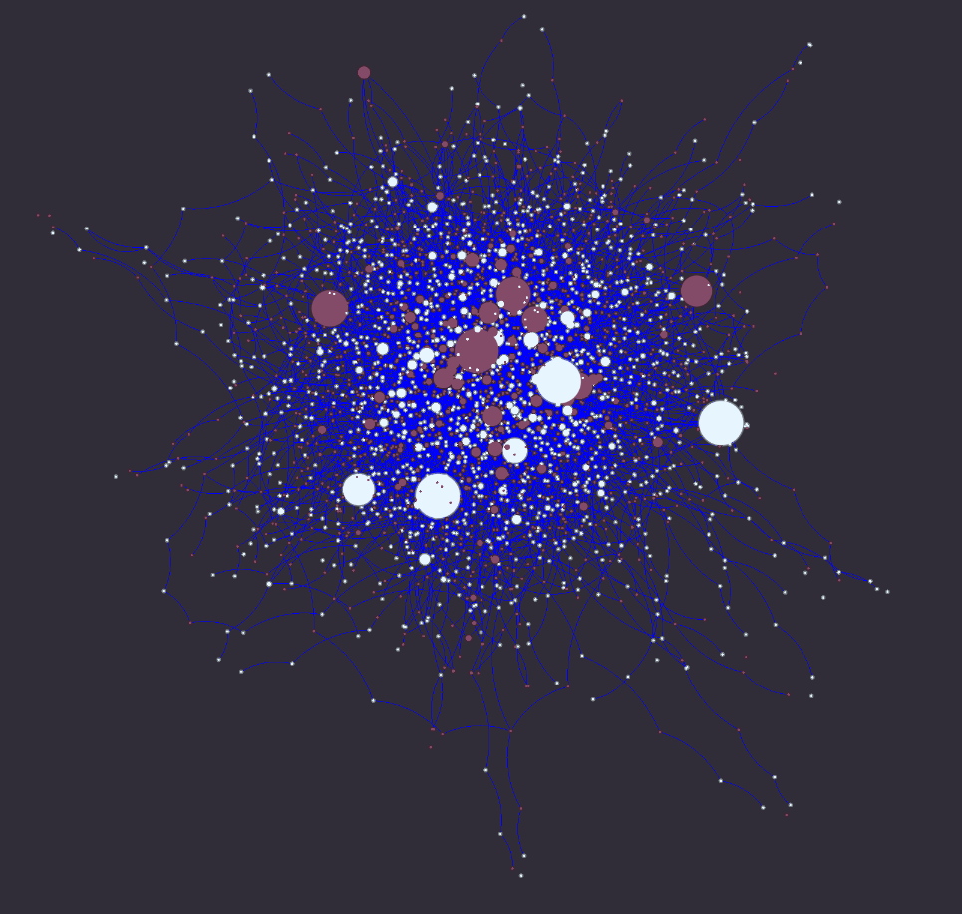
In 2009, Sina Weibo had:
~1.8M users,
~300K original posts
~24M retweets
Most of the posts originate with a few “influencers”, whose messages were retweeted many times.
Node (A)
Node (B)
Edge
Notes:
In 2009, Sina Weibo – a Twitter-like platform in China – had over 1.7 million users who retweeted MILLIONS OF messages. Most of these originated with a few “influential” users, whose original messages were retweeted many times. This graph displays a subset of the Sina Weibo network, where each dot – or node – represents a user and each line between the nodes – or edge – represents a retweet. The two colors of our nodes - red and light blue - represent 2 categories as a measure of diversity of people in the network. Let’s call the light color group A and the red color group B. Gender is one attribute we were able to measure in the Sina Weibo network so you can think of group A as male and group B as female, but you can also have other attributes - like age or location - and multiple categories within attributes.
FROM INFECTOR PAPER (FYI)
We examined this question in the diffusion cascades of the Weibo dataset, a network consisting of more than 1.7 million nodes and 0.4 billion edges, accompanied by a set of 300,000 retweet cascades spanning 3 years of recordings. The network is retrieved at the final month of these 3 years. The diffusion cascades are formed by gathering the past 1,000 tweets of each node in the network, resulting in a retweet network of over 24M connections. The original posts in these tweets represent the start of a cascade, and any tweet with the same content, that is not an original post and is preceded by the initial tweet, is considered a retweet. We should underline here that the original post is not defined based on time precedence, we know which tweet is the original post because it is the only tweet of a given content that is not marked as a retweet

Slide 48
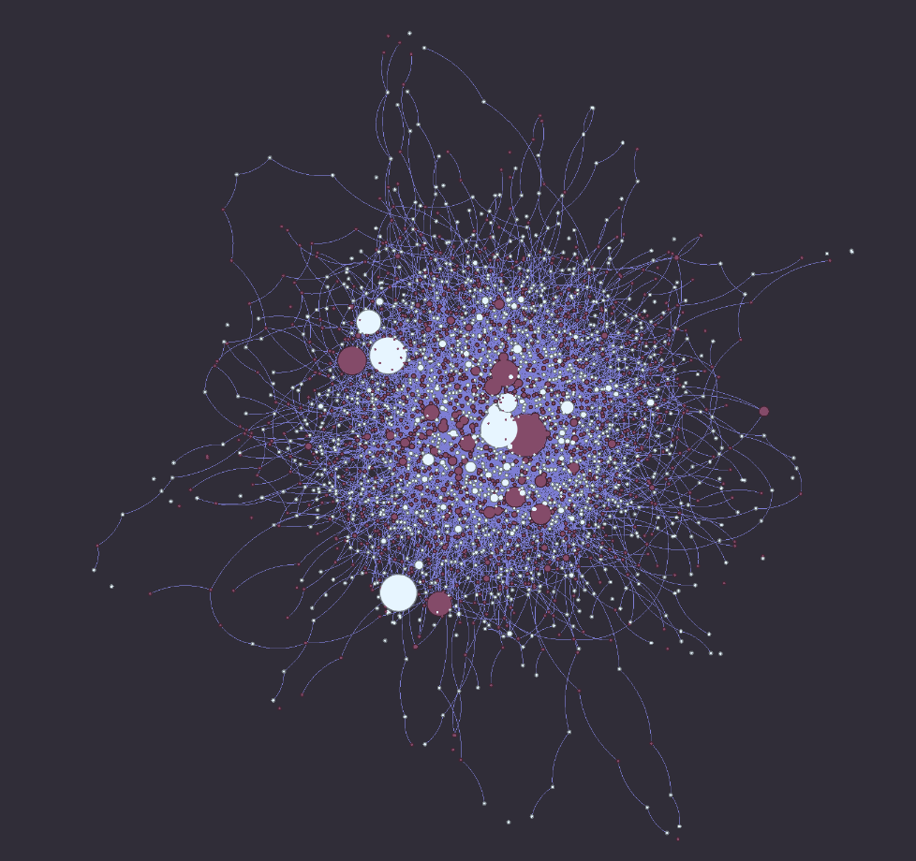
In 2009, Sina Weibo had:
~1.8M users,
~300K original posts
~24M retweets
Most of the posts originate with a few “influencers”, whose messages were retweeted many times.
Node (A)
Node (B)
Edge
Notes:
In 2009, Sina Weibo – a Twitter-like platform in China – had over 1.7 million users who retweeted MILLIONS OF messages. Most of these originated with a few “influential” users, whose original messages were retweeted many times. This graph displays a subset of the Sina Weibo network, where each dot – or node – represents a user and each line between the nodes – or edge – represents a retweet. The two colors of our nodes - red and light blue - represent 2 categories as a measure of diversity of people in the network. Let’s call the light color group A and the red color group B. Gender is one attribute we were able to measure in the Sina Weibo network so you can think of group A as male and group B as female, but you can also have other attributes - like age or location - and multiple categories within attributes.
FROM INFECTOR PAPER (FYI)
We examined this question in the diffusion cascades of the Weibo dataset, a network consisting of more than 1.7 million nodes and 0.4 billion edges, accompanied by a set of 300,000 retweet cascades spanning 3 years of recordings. The network is retrieved at the final month of these 3 years. The diffusion cascades are formed by gathering the past 1,000 tweets of each node in the network, resulting in a retweet network of over 24M connections. The original posts in these tweets represent the start of a cascade, and any tweet with the same content, that is not an original post and is preceded by the initial tweet, is considered a retweet. We should underline here that the original post is not defined based on time precedence, we know which tweet is the original post because it is the only tweet of a given content that is not marked as a retweet

Slide 49
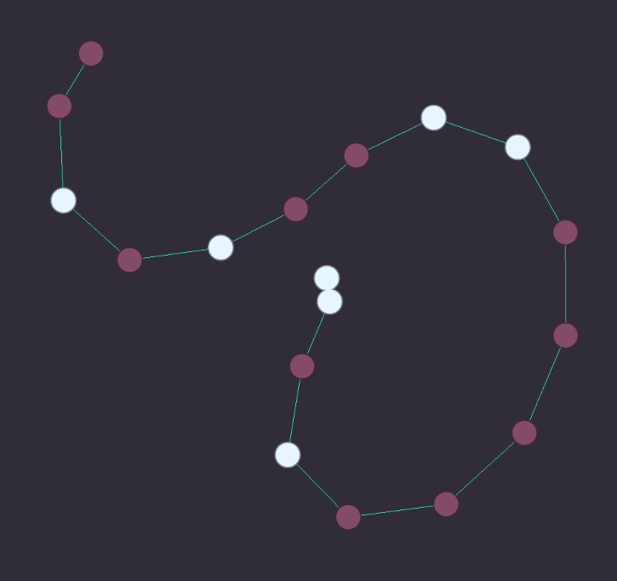
If the cascade distribution for a given attribute looks similar to that of the broader network, we might think of this as “fair”.
(demographic parity)
?=
Notes:
Our project updates influence maximization to find the most fair and impactful influencers.

Slide 50
In a Social Network, how might we find influencers who can maximize the spread of information fairly?
Applies to many applications: an ad, call for donations, critical public health information….

Slide 51
Influence maximization algorithms solve this problem
Finds the set of K influencers that maximize information spread in a network.

Slide 52
Sina Weibo Network:
~1.8M users:
30% male
70% female
~300K original posts
~24M retweets
Most of the posts originate with a few influencers, whose messages were retweeted many times through cascades.

Slide 53
If the cascade distribution for a given attribute looks similar to that of the broader network, we might think of this as “fair”.
Our project updates influence maximization to find the most fair and impactful influencers.
?=
Notes:
Some influencers share information with many different people, who might represent a diversity of genders, classes, races, ethnicities, et cetera. Others might share information just as widely, but only with a certain group. These are two cascades, and the bar charts represent the proportion of people in the cascade who identify as women or men. Our large influencer from before (shown on the left) has started large cascades where mostly people who identify as women are retweeting their message. A new large influencer (shown on the right) has started almost as large cascades but their cascades have about an equal proportion of people who identity as women and people who identify as men.

Slide 54
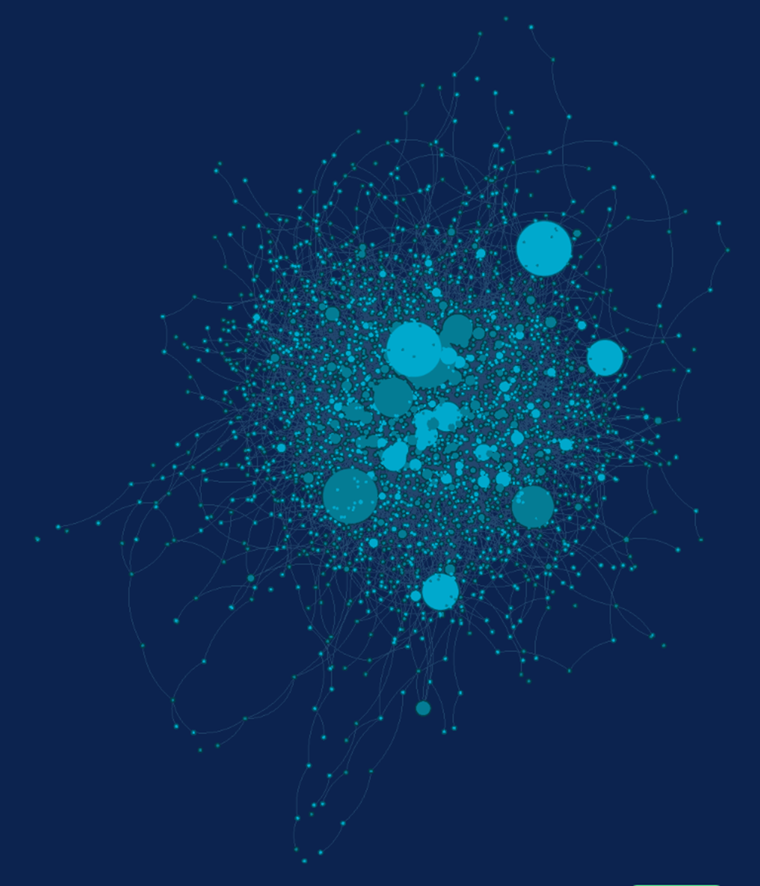
In 2009, Sina Weibo had:
~1.8M users,
~300K original posts
~24M retweets
Most of the posts originate with a few “influencers”, whose messages were retweeted many times.

Slide 55
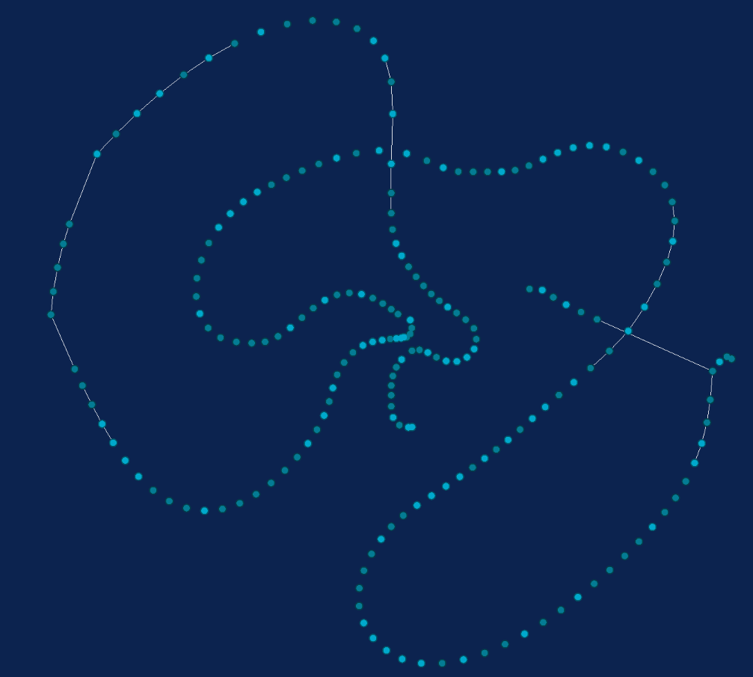
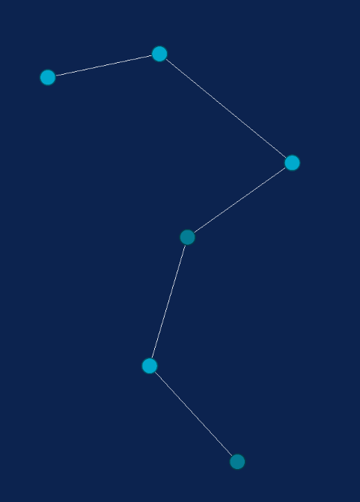
Some influencers start massive “cascades”, or large chains of retweeting.
The largest cascade in this Sina Weibo dataset is over 50,000 retweets long.
Notes:
Some influencers start huge chains of retweeting, where their message is retweeted over an over. This is called a cascade. The largest cascade in this Sina Weibo network is over 50,000 retweets long. The larger hairball-like structure on the left is not that large, but is an example of someone that seems to have greater influence in the network than the tiny chain on the lower right. > 200 vs 6

Slide 56
How might we find influencers who can maximize the spread of our message?
Applies to any message: an ad, call for donations, critical public health information….
Notes:
What if we have a message we want to share widely on Sina Weibo? How might we find the right influencers, who will be able to start these large cascades and share that message with the most people? This problem could apply to any kind of message, like an ad about a product we want to sell, a call for donations for a cause, or important information many people should know, like information about the COVID-19 vaccine.

Slide 57
“Influence maximization” algorithms solve this problem
Finds the set of K influencers that maximize information spread in a network.
Notes:
Some influencers share information with many different people, who might represent a diversity of genders, classes, races, ethnicities, et cetera. Others might share information just as widely, but only with a certain group. These are two cascades, and the bar charts represent the proportion of people in the cascade who identify as women or men. Our large influencer from before (shown on the left) has started large cascades where mostly people who identify as women are retweeting their message. A new large influencer (shown on the right) has started almost as large cascades but their cascades have about an equal proportion of people who identity as women and people who identify as men.

Slide 58
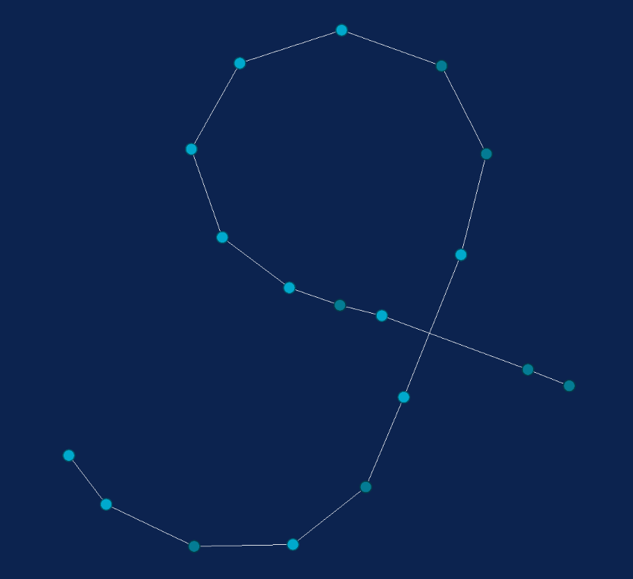
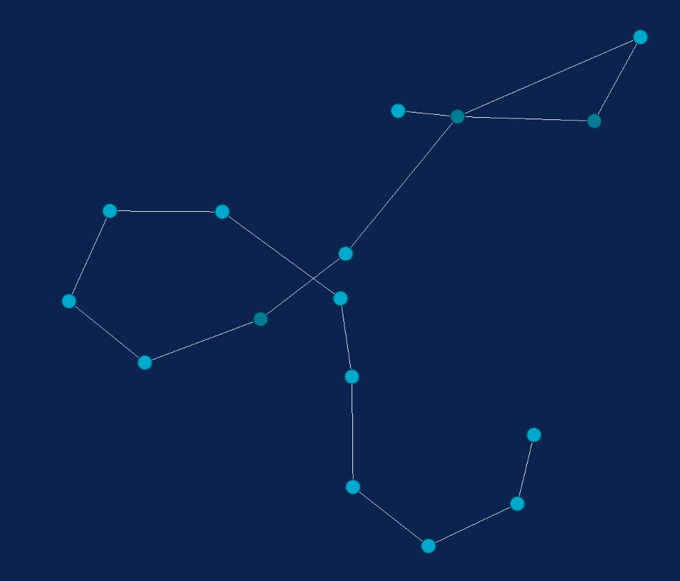
Some influencers start cascades including many different kinds of people. Others share information better with certain groups.
Notes:
Some influencers share information with many different people, who might represent a diversity of genders, classes, races, ethnicities, et cetera. Others might share information just as widely, but only with a certain group. These are two cascades, and the bar charts represent the proportion of people in the cascade who identify as women or men. Our large influencer from before (shown on the left) has started large cascades where mostly people who identify as women are retweeting their message. A new large influencer (shown on the right) has started almost as large cascades but their cascades have about an equal proportion of people who identity as women and people who identify as men.

Slide 59
If the cascade distribution for a given attribute looks similar to that of the broader network, we might think of this as “fair”.
(demographic parity)
?=
Notes:
Some influencers share information with many different people, who might represent a diversity of genders, classes, races, ethnicities, et cetera. Others might share information just as widely, but only with a certain group. These are two cascades, and the bar charts represent the proportion of people in the cascade who identify as women or men. Our large influencer from before (shown on the left) has started large cascades where mostly people who identify as women are retweeting their message. A new large influencer (shown on the right) has started almost as large cascades but their cascades have about an equal proportion of people who identity as women and people who identify as men.

Slide 60
Our project updates influence maximization to find the most fair and impactful influencers.

